Slide 1
CSE 280 Discrete Mathematics
Week 02 Day 2
W. Clements
Predicates & Qualifiers 1.6-1.7

Slide 2
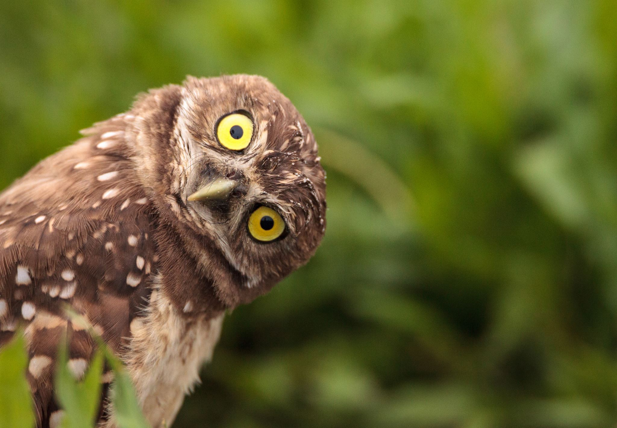

Consider the statement:
$x>5$
Is this a proposition?
$x+1>x$
Is this a proposition?
$x$ is even
Proposition?
Each of these statements has two parts: a variable and a predicate.
A predicate is a T/F statement that depends on one or more variables.
$P(x)$ = "$x$is even"

Slide 3

Consider the statement:
$x>5$
Let $P(x)$ represent the predicate "$x$ is greater than 5"
Now, we can turn it into a proposition by giving $x$ a value.
What is the truth value of:
$P(4)$?
$P(6)$?

Slide 4


Example:
Let $V(x)$ be the statement "Computer x has a virus."
Of all the computers on campus, only CS1 and EE2 have a virus.
What are the truth values of:
$V\left(CS1\right)?$
$V\left(CS2\right)?$

Slide 5
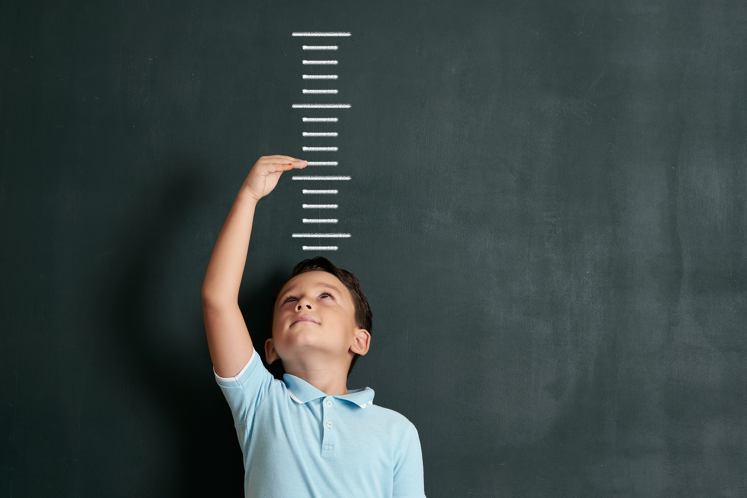

Example:
$Q\left(x,y\right)=$"$x$ is taller than $y$", where the domain is students in this class
What is the truth value of:
$Q\left(Bob, Sue\right)?$
Fill in the names of each member of your group.

Slide 6

What is a predicate?
A T/F statement that depends on one or more variables
A function that returns True or False
What are the possible inputs (AKA domain)?
What are the possible outputs (AKA codomain)?
Python Example
seq = [0, 1, 2, 3, 5, 8, 13]
result = list(filter(lambda x: x%2 != 0, seq))
What is the predicate?
It depends
{true, false}
True
False
example

Slide 7

Quantifiers
This is called "Quantification"
Predicates are not propositions because they contain free variables.
One way to turn a predicate into a proposition is by assigning values to the variables.
Another way to create a proposition from a predicate is to assign a range of values rather than plugging in specific values.
$P\left(x\right): x<5$
$P\left(4\right)=True$

Slide 8



Quantifiers
This is called "Quantification"
Another way to create a proposition from a predicate is to assign a range of values rather than plugging in specific values.
Let $P(x)$ be the predicate "x is greater than 5"
Is $P(x)$ true for ALL values of $x?$
Is $P(x)$ true for SOME values of $x?$
$$∀x P(x)$$
$$∃x P(x)$$

Slide 9
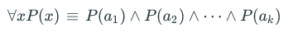
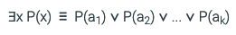



Quantifier Symbols
$∀$ Universal quantifier.
Meaning: For every, Every, All, For all
$∃$ Existential quantifier.
Meaning: There is at least one, some, for some, at least one, there is
$¬∀$ Not every
$¬∃$ There is not one, there are none, there are not any
LaTeX for $∀$ is \forall
LaTeX for $∃$ is \exists

Slide 10



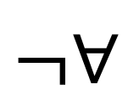
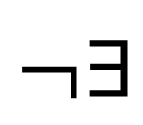

Review Quantifier Symbols
Name it
What does it mean in English?
$∀$
Universal quantifier
For every, Every, All, For all
$∃$
Existential quantifier
There is at least one, some, for some, at least one, there is
$¬∀$
Universal quantifier,
negated
Not every, not all
$¬∃$
Existential quantifier,
negated
There is not one, there are none, there are not any, none
LaTeX for $∀$ is \forall
LaTeX for $∃$ is \exists

Slide 11
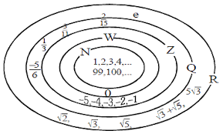


Example:
Let $P\left(x\right)$ represent the statement $x+1>x$
What is the truth value of:
$∀x P(x)$, where the universe of discourse or domain is $ℝ$
We can also say:
$∀x∈ℝ, P(x)$
$ℝ$ = Real Numbers

Slide 12

Example:
Let $P\left(x\right)$ represent the statement $x>3$
What is the truth value of:
$∀x P(x)$, where the domain is $ℝ$
$∃x P(x)$

Slide 13
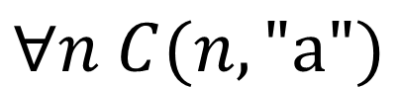
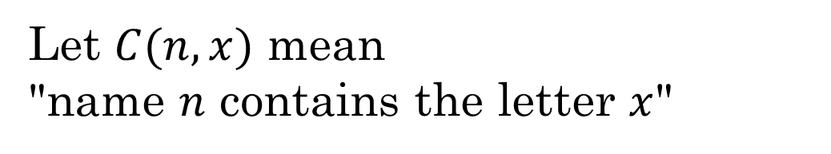
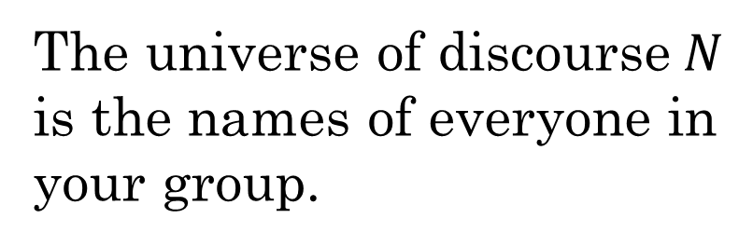
Is it True?
The universe of discourse$N$
is the names of everyone in
your group.
Let $C(n, x)$ mean
"name $n$ contains the letter $x$"
$$∀n C(n,"a")$$

Slide 14
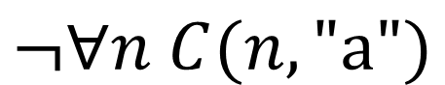
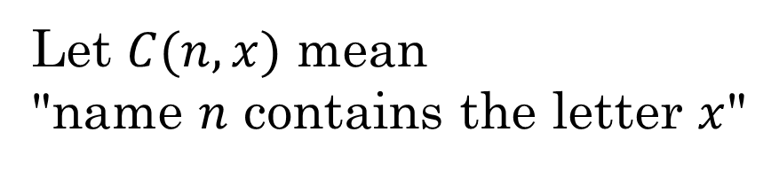
Is it True?
The universe of discourse$N$
is the names of everyone in
your group.
Let $C(n,x)$ mean
"name $n$ contains the letter $x$"
$$¬∀n C(n,"a")$$

Slide 15
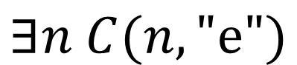
Is it True?
The universe of discourse$N$
is the names of everyone in
your group.
Let $C(n,x)$ mean
"name $n$ contains the letter $x$"
$$∃n C(n,"e")$$
How can we express this in Python, without using loops?
len(list(filter(lambda name: 'e' in name, names))) > 0
example

Slide 16
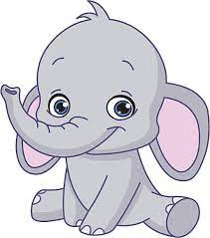


Example:
Express this as a quantified statement:
All elephants are gray.
$∀x \left(Elephant\left(x\right)→Gray\left(x\right)\right)$
Some dogs are white.
$∃x \left(Dog\left(x\right)∧White\left(x\right)\right)$

Slide 17

Practice converting to English:
$$∃x∃y \left(\left(\left(x≥0\right)∧\left(y≥0\right)\right)→\left(xy≥0\right)\right)$$
"For some x and some y, when x≥0 and y≥0 then x times y will be greater than or equal to zero."
Better way:
"The product of some two non-negatives is non-negative"
2 * 3 = 6

Slide 18

Practice converting to English:
$$∀x∀y \left(\left(x<0\right)∧\left(y<0\right)→\left(xy>0\right)\right)$$
"For all x and y, if they are both less than 0 then their product is greater than 0."
Better way:
"The product of two negatives is positive."
-2 * -3 = 6

Slide 19

Practice converting to English:
$$∀x∀y\left(\left(\left(x>0\right)∧\left(y>0\right)\right)→\left(\left(\frac{x+y}{2}\right)>0\right)\right)$$
"For all x and y, if they are both greater than 0 then adding them together and dividing by 2 is greater than 0."
Better way:
"The average of two positives is positive."
$\frac{3+7}{2}=5$

Slide 20

Practice converting to English:
$$∀x∀y\left(\left(\left(x<0\right)∧\left(y<0\right)\right)→\left(x−y<0\right)\right)$$
"For all x and y, if they are both negative, then subtracting the second from the first results in a negative number."
Better way:
"The difference of two negatives is negative."
Is this true?
No. We can prove it False using a counterexample:
$$−3 −−4=1$$

Slide 21
In Class Exercise
Let's look at quantifiers using Python
Colab Demo

Slide 22
Homework 2 Review
Share your homework solutions with one other person
2.4 2.5
The domain for this exercise is the set of all people, and:
𝐹(𝑥) = 𝑥 is a friend 𝐶(𝑥) = 𝑥 is cool 𝑆(𝑥) = 𝑥 is a student 𝑁(𝑥) = 𝑥 is from Nepal
Express in good English the following statements:
∀𝑥 (𝐹(𝑥)→𝐶(𝑥))
∃𝑥 (𝐹(𝑥)∧𝐶(𝑥))
∀𝑥 (𝐹(𝑥)∧𝐶(𝑥))
∃𝑥 (𝐹(𝑥)→𝐶(𝑥))
∀𝑥 (𝑆(𝑥)→𝑁(𝑥))
∃𝑥 (𝑆(𝑥)→𝑁(𝑥))
∀𝑥 (𝑆(𝑥)∧𝑁(𝑥))
∃𝑥 (𝑆(𝑥)∧𝑁(𝑥))
Translate the following statements into logical expressions using predicates, quantifiers, and logical connectives:
Everyone's a critic.
No one is perfect.
At least one of your friends is perfect.
All of your friends are critics.
Everyone is a critic or someone is your friend.
No one is a critic and everyone is your friend.
Some state has no neighboring states.
Whenever there is an error, at least one error message is displayed.
All the programs have been scanned, but at least one program has a virus.

Slide 23
Work as a team
Additional Exercises:
1.6.2
1.7.2
1.7.3
1.7.4
1.7.6

Slide 24
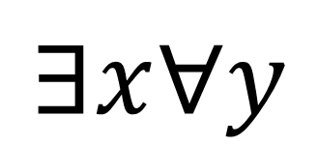
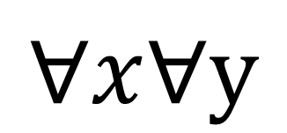
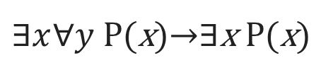

More Quantifiers
$$∀x∀y$$
$$∃!x (x=3)$$
∀x (F(x)→C(x))
$∃x∀y$ P(x)→∃x P(x)
∃x (S(x)∧N(x))
$$∃x∀y$$

